Slide 1

Chapter 5
Local Area Networks
5.<number>

Slide 2
Introduction
A local area network is a communication network that interconnects a variety of data communicating devices within a small geographic area and broadcasts data at high data transfer rates
Since the local area network first appeared in the 1970s, its use has become widespread in commercial and academic environments
5.<number>

Slide 3
Primary Function of Local Area Networks
To provide access to hardware and software resources that will allow users to perform one or more of the following activities:
  File serving
    A large storage disk drive acts as a central storage repository
  Print serving
    Providing the authorization to access a particular printer, accept and queue print jobs, and providing a user access to the print queue to perform administrative duties
  Video transfers
    High speed LANs are capable of supporting video image and live video transfers
5.<number>

Slide 4
Primary Function of Local Area Networks (continued)
To provide access to hardware and software resources that will allow users to perform one or more of the following activities (continued):
  Academic support
    In classrooms, labs, and wireless
  E-mail support
5.<number>

Slide 5
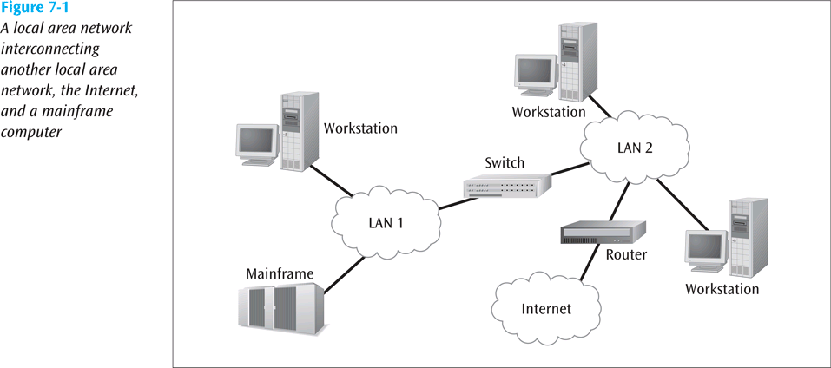
Primary Function of Local Area Networks (continued)
5.<number>

Slide 6
Advantages and Disadvantages of Local Area Networks
Advantages
  Ability to share hardware and software resources
  Individual workstation might survive network failure
  Component and system evolution are possible
  Support for heterogeneous forms of hardware and software
  Access to other LANs and WANs
  Private ownership
  Secure transfers at high speeds with low error rates
5.<number>

Slide 7
Advantages and Disadvantages of Local Area Networks (continued)
Disadvantages
  Equipment and support can be costly
  Level of maintenance continues to grow
  Some types of hardware may not interoperate
  Just because a LAN can support two different kinds of packages does not mean their data can interchange easily
  LAN is only as strong as its weakest link, and there are many links
5.<number>

Slide 8
The First Local Area Network – The Bus/Tree
The original topology
Workstation has a network interface card (NIC) that attaches to the bus (a coaxial cable) via a tap
Data can be transferred using either baseband digital signals or broadband analog signals
5.<number>

Slide 9
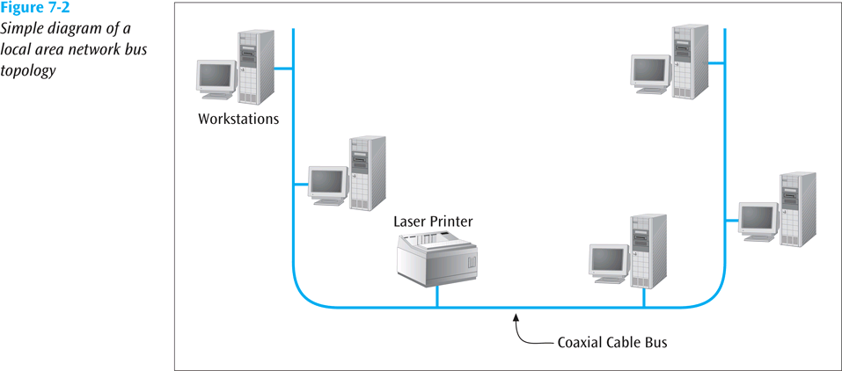
Bus/Tree (continued)
5.<number>

Slide 10
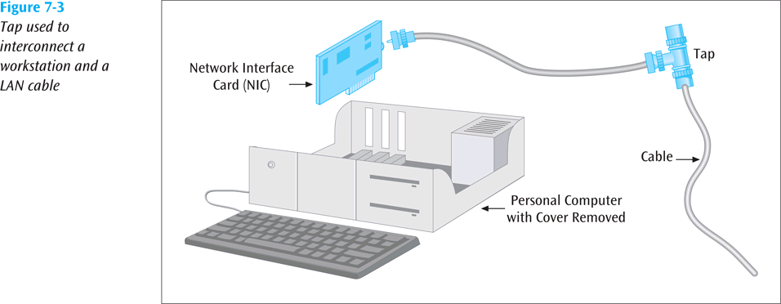
Bus/Tree (continued)
5.<number>

Slide 11
Bus/Tree (continued)
Baseband signals are bidirectional and more outward in both directions from the workstation transmitting
Broadband signals are usually uni-directional and transmit in only one direction
Buses can be split and joined, creating trees
5.<number>

Slide 12
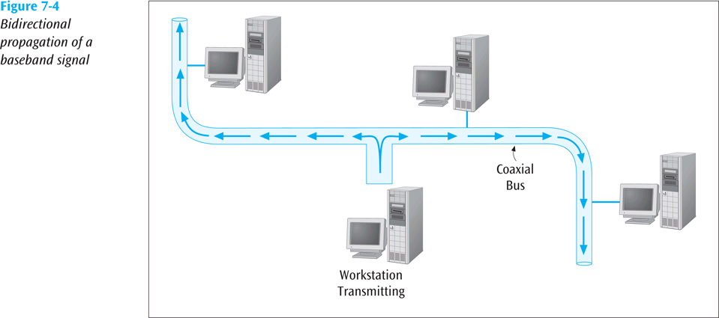
Bus/Tree (continued)
5.<number>

Slide 13
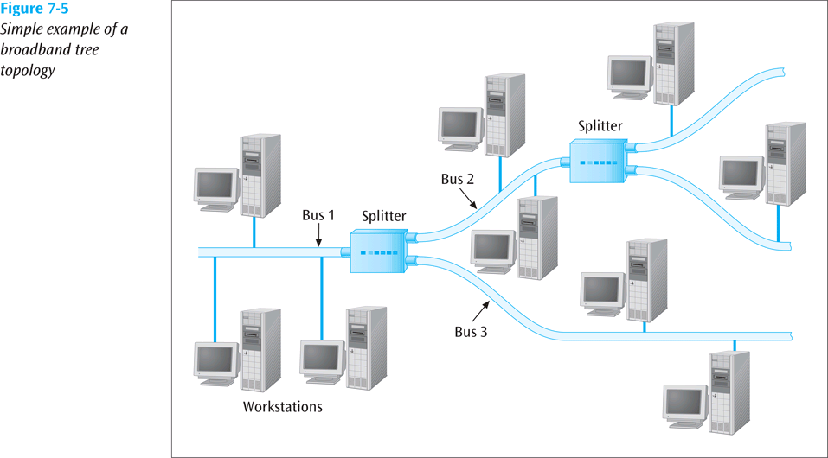
Bus/Tree (continued)
5.<number>

Slide 14
A More Modern LAN – The Star-Wired Bus
Logically operates as a bus, but physically looks like a star
Star design is based on hub
  All workstations attach to hub
Unshielded twisted pair usually used to connect workstation to hub
Originally, hub takes incoming signal and immediately broadcasts it out all connected links
Hubs can be interconnected to extend size of network
5.<number>

Slide 15
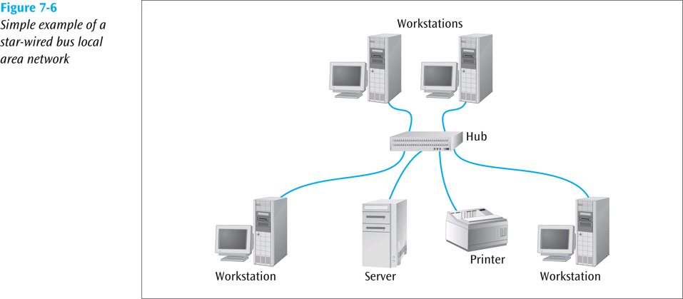
Star-Wired Bus (continued)
5.<number>

Slide 16
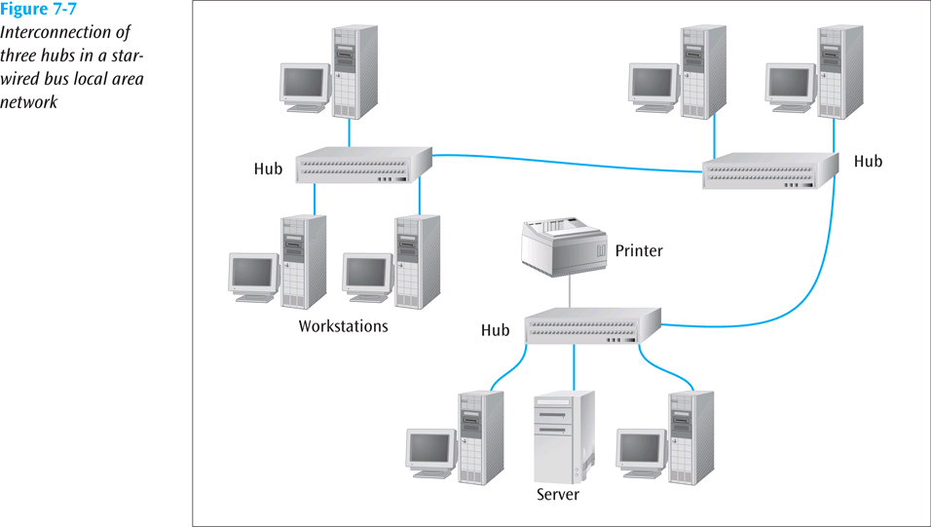
Star-Wired Bus (continued)
5.<number>

Slide 17
Star-Wired Bus (continued)
Hubs can be interconnected with twisted pair, coaxial cable, or fiber-optic cable
Biggest disadvantage = when one station talks, everyone hears it
  This is called a shared network
    All devices are sharing the network medium
5.<number>

Slide 18
Medium Access Control Protocols
How does a workstation get its data onto the LAN medium?
A medium access control protocol is the software that allows workstations to “take turns” at transmitting data
Two basic categories:
  Contention-based protocols
  Round-robin protocols
5.<number>

Slide 19
Contention-Based Protocols
Essentially first-come, first-served
Most common example is carrier sense multiple access with collision detection (CSMA/CD)
If no one is transmitting, workstation can transmit
If someone else is transmitting, workstation “backs off” and waits
5.<number>

Slide 20
Contention-Based Protocols (continued)
If two workstations transmit at same time, collision occurs
  When two workstations hear collision, they stop transmitting immediately
  Each workstation backs off a random amount of time and tries again
  Hopefully, both workstations do not try again at exact same time
5.<number>

Slide 21
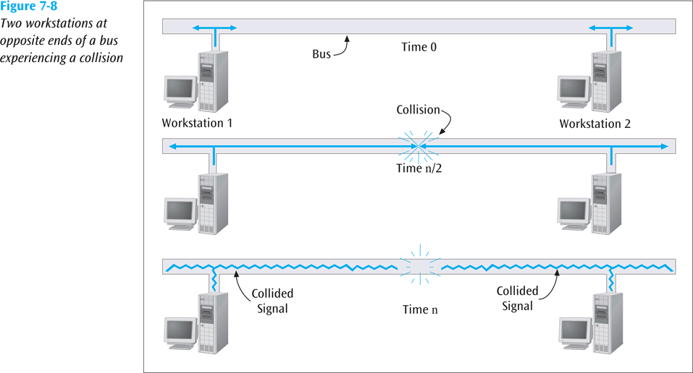
Contention-Based Protocols (continued)
5.<number>

Slide 22
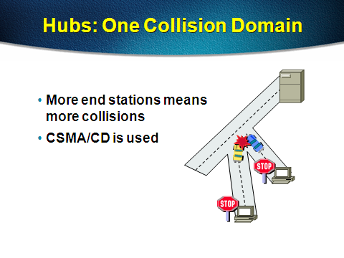
Hub
The hub is a simple device that transmits an incoming frame out all the other ports on the hub
5.<number>

Slide 23
Bridged Ethernet
Bridges have two effects on an Ethernet LAN:
  They raise the bandwidth
  They separate collision domains.
5.<number>

Slide 24

Raising the Bandwidth
A bridge divides the network into two or more networks. Bandwidth-wise, each network is independent.
For example, in The Figure, a network with 12 stations is divided into two networks, each with 6 stations.
Now each network has a capacity of 10 Mbps. The 10-Mbps capacity in each segment is now shared between 6 stations, not 12 stations.
5.<number>
A network with and without a bridge

Slide 25

Separating Collision Domains
Another advantage of a bridge is the separation of the collision domain.
You can see that the collision domain becomes much smaller and the probability of collision is reduced tremendously.
Without bridging, 12 stations contend for access to the medium; with bridging only 3 stations contend for access to the medium.
Collision domains in an unbridged network and a bridged network
5.<number>

Slide 26
Switches
The switch has intelligence and can filter out and forward frames based on their NIC address
A switch maintains internal port table(s) that keep track of which frames arrived on which ports
Switched Ethernet is always full-duplex
5.<number>

Slide 27
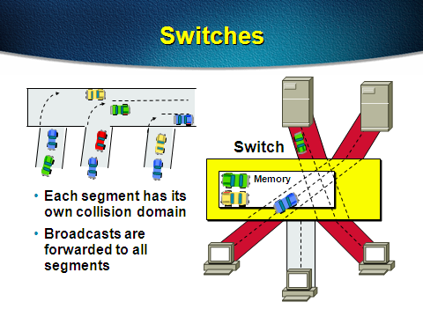
Switches
5.<number>

Slide 28
Switches (continued)
A switch observes each frame that arrives at a port, extracts the source address from the frame, and places that address in the port’s routing table
Workstations that connect to a hub are on a shared segment
Workstations that connect to a switch are on a switched segment
5.<number>

Slide 29
Virtual LANs
Virtual LAN (VLAN) – logical subgroup within a LAN that is created via switches and software rather than by manually moving wiring from one network device to another
Even though employees and their actual computer workstations may be scattered throughout the building, LAN switches and VLAN software can be used to create a “network within a network”
5.<number>

Slide 30
Virtual LANs (continued)
A relatively new standard, IEEE 802.1Q, was designed to allow multiple devices to intercommunicate and work together to create a virtual LAN
5.<number>

Slide 31

Addressing
Each station on an Ethernet network (such as a PC, workstation, or printer) has its own network interface card (NIC). The NIC fits inside the station and provides the station with a 6-byte physical address. As shown in the below, the Ethernet address is 6 bytes (48 bits), normally written in hexadecimal notation, with a colon between the bytes.
Example of an Ethernet address in hexadecimal notation
5.<number>

Slide 32
Unicast and multicast addresses
Unicast, Multicast, and Broadcast Addresses
A source address is always a unicast address-the frame comes from only one station.
The destination address, however, can be unicast, multicast, or broadcast.
5.<number>

Slide 33
STANDARD ETHERNET
The original Ethernet was created in 1976 at Xerox’s Palo Alto Research Center (PARC). Since then, it has gone through four generations. We briefly discuss the Standard (or traditional) Ethernet in this section.
Most common form of LAN today
Star-wired bus is most common topology.
Comes in many forms depending upon medium used and transmission speed and technology
5.<number>

Slide 34

Ethernet evolution through four generations
5.<number>

Slide 35
Wired Ethernet (continued)
One of the latest features is power over Ethernet (PoE)
What if you have a remote device that has an Ethernet connection?
  It will require a power connection
What if you don’t have an electrical outlet nearby?
  Use PoE
    Power to drive Ethernet NIC is sent over wiring along with usual Ethernet signals
5.<number>

Slide 36
Wireless Ethernet
Not really a specific topology
  Workstation in a wireless LAN can be anywhere as long as it is within transmitting distance to an access point
Several versions of IEEE 802.11 standard define various forms of wireless LAN connections
5.<number>

Slide 37
Wireless Ethernet (continued)
Two basic components necessary:
  Client radio
    Usually a PC card with an integrated antenna installed in a laptop or workstation
  Access point (AP)
    An Ethernet port plus a transceiver
AP acts as a bridge between the wired and wireless networks and can perform basic routing functions
Workstations with client radio cards reside within Basic Service Set, while multiple basic service sets create an Extended Service Set
5.<number>

Slide 38
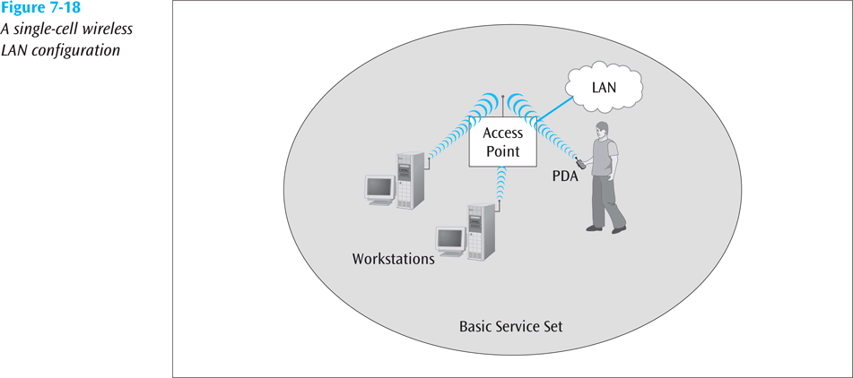
Wireless Ethernet (continued)
5.<number>

Slide 39
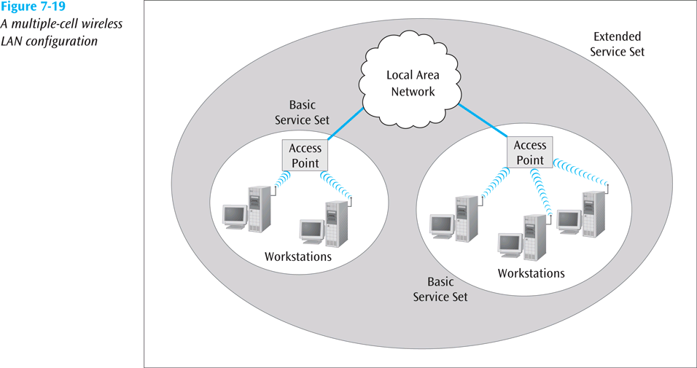
Wireless Ethernet (continued)
5.<number>

Slide 40
Wireless Ethernet (continued)
IEEE 802.11
  Original wireless standard, capable of transmitting data at 2 Mbps
IEEE 802.11b
  Second wireless standard, capable of transmitting data at 11 Mbps
5.<number>

Slide 41
Wireless Ethernet (continued)
With directional antennae designed for point-to-point transmission (rare), 802.11b can transmit for more than 10 miles
With an omni-directional antenna on typical AP, range may drop to as little as 100 feet
5.<number>

Slide 42
Wireless Ethernet (continued)
IEEE 802.11a
  One of the faster standards
  Capable of transmitting data at 54 Mbps (theoretical) using the 5-GHz frequency range
IEEE 802.11g
  Another fast standard
  Also capable of transmitting data at 54 Mbps (theoretical) but using the same frequencies as 802.11b (2.4-GHz)
5.<number>

Slide 43
Wireless Ethernet (continued)
IEEE 802.11n (100 Mbps) is the latest standard to be approved
802.11n uses MIMO technology (multiple input multiple output)
5.<number>

Slide 44
Wireless Ethernet (continued)
HiperLAN/2 (European standard, 54 Mbps in 5-GHz band)
To provide security, most systems use either:
  Wired Equivalent Privacy (WEP) – provides either 40- or 128-bit key protection
  WPA or some other more advanced standard
Wireless LANs may also be configured without an access point
  These configurations are called “ad-hoc”
5.<number>

Slide 45
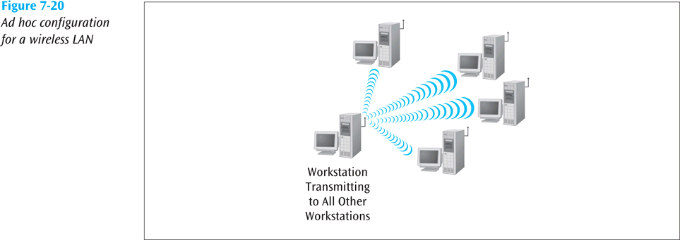
Wireless Ethernet (continued)
5.<number>

Slide 46
Wireless CSMA/CA
CA (Collision avoidance)
  Protocol does not listen and detect collisions
  Instead, tries to avoid collisions before they happen
How does CSMA/CA do this?
  All devices, before they transmit, must wait an amount of time called an inter frame space (IFS)
  Some applications have a short IFS, while others have a long IFS
    If two applications want to transmit at same time, the application with shorter IFS will go first
5.<number>

